Slide 1
Will online digital streaming services take over the movie theaters?
Asish Addepalli(aa9335, N19960014)
Lakshmi Sai Anmol Ramayanam(lr2947, N12320210)
Prasanna Kumar Chidire(pkc4609, N18329913)
Yashasvi Choukikar(yc4953, N17770957)
Project link: https://github.com/ARamayanam097/SocialNetworkProject

Slide 2
ABSTRACT
Seismic Shift in Medium
COVID-19 pandemic led to significant change in way movies are released and consumed
1
Popularity of online streaming services
Online streaming platforms experienced a surge in popularity due to lockdowns worldwide in 2020
2
Surveys
With the help of survey, we would want to test our hypothesis that online streaming platforms will replace movie theatres
3
Survey Conclusion
The survey highlights that although the way people watch movie may change, movie theaters capacity to evoke emotions is timeless
4

Slide 3
HYPOTHESIS
Movies are important in reflecting and shaping society.
Online streaming platforms provide time flexibility and personalization
Wider reach of these platforms have significantly improved the quality of movies
Online streaming platforms will replace movie theatres

Slide 4
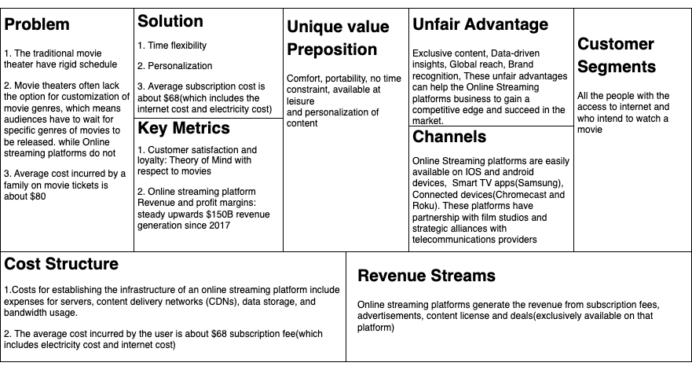
Business Canvas Model

Slide 5
Assessing Business Model
Falsifiability
The presentation will rely on data and industry trends to support its arguments and hypotheses, and it will present counter arguments to demonstrate the falsifiability of its claims. Additionally, it will provide recommendations for movie theater owners and online streaming platforms to adapt to the changing landscape and coexist in a mutually beneficial way.
Motivation
The rise of online digital streaming services, such as Netflix, Hulu, and Amazon Prime, has changed the way people consume media. As more and more people turn to these services for their entertainment needs, there is a growing question of whether they will eventually take over the traditional movie theater experience.
Value Proposition
Movie theaters cost an average family of four $80 for a two-hour movie outing, while online platforms offer a bundle subscription for less than $80 per month. This project explores the impact of online streaming services on the movie theater industry and examines the benefits and drawbacks of both mediums.

Slide 6
Literature Review
The paper’s are titled as follows:
Is Ott Industry A Disruption To Movie Theatre Industrystry?
Ott V Theatre: Anticipating Trends Post Pandemic
The Future Of Movies: Will Ott Take Over Theaters
Examines young people's video viewing habits in theaters and on digital platforms, finding that 50% of respondents believe that OTT platforms are hurting movie theaters. The paper concludes with 16 observations and asserts that both platforms strive to maintain their distinctiveness.
Looks at the rise of OTT viewership since 2020, detailing its subscription model and heavy investments. The paper concludes that while people's media consumption patterns have changed due to OTT, the movie business is not in decline. However, filmmakers express concern that the proliferation of OTT platforms could be the "final death blow" for movie theaters.
Analyzes the perception of OTT platforms and movie theaters among 120 survey respondents, using descriptive statistics and key metrics. The paper concludes that predominantly male subscribers have contributed to the rise of OTT, and that OTT is the future.

Slide 7
Prior Art Improvements
Consumer Perspective
Theory of Mind
Novelty
Current research on online movie platforms mainly focuses on producers and costs, neglecting the social and emotional attachment of movies to the human psyche.
Our study aims to bring the consumer perspective into consideration, including the role of theory of mind in understanding the connection between viewers and the entertainment industry.
We explore the social aspect of movie viewing as a means of connecting with others and include theory of mind as a novel parameter, which has not been covered in previous literature surveys.

Slide 8
Minimum Viable Experiment
Conclusion
This experiment provides valuable insights into the evolving movie-viewing experience and help us understand the potential dominance of online streaming platforms over traditional cinemas.
Survey
A survey is conducted to understand the potential impact of online streaming platforms on the traditional cinema-going experience.
05
Vestibulum congue
01
04
Insights
Insights gained from the survey data and revenue data can help us understand the impact of OTT platforms on social, economic and cultural connections.
Survey Questionnaire
The survey includes questions about movie-watching habits, attitudes towards movie theaters and OTT platforms, and the overall perception of movies in society.
02
03
Data Analysis
Data collected from the survey is analyzed to identify trends and patterns.
Revenue made by movies and online streaming services gotten and analysis done on the same data

Slide 9


Data Collections
We have conducted a survey to collect the data. The survey contained demographic information like age and gender and then we asked about their movie preferences, genre preferences, and about their active subscriptions to the online streaming services and the effect it has on their social life and mental health and we ended the survey by asking with so many benefits from online streaming platforms if they would stop going to the movie theaters
We collected data of the revenue generated by the online streaming platforms from the year 2016 and we got the box office collections information from the year 2010. From the collected data we would want to check the trends
Survey link : https://docs.google.com/forms/d/e/1FAIpQLSfgyx6t7POUUOFH_Jyjf9ZUg5xlhqC8qbxY80Kw2yqpTzA-9w/viewform?usp=sf_link

Slide 10
Survey group demographics
Women
Men
36.4%
VOTING INTENTION
1%
62.6%
Others

Slide 11
Survey group demographics
44%
Under 20 years
2%
20-35 years
35-50 years
34%
Above 50
20%

Slide 12
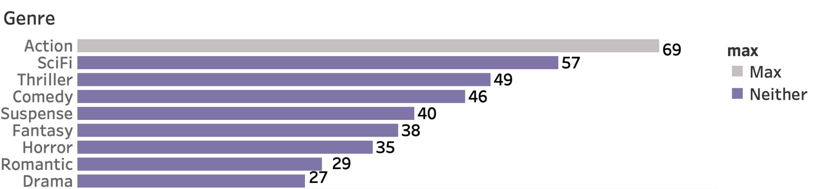
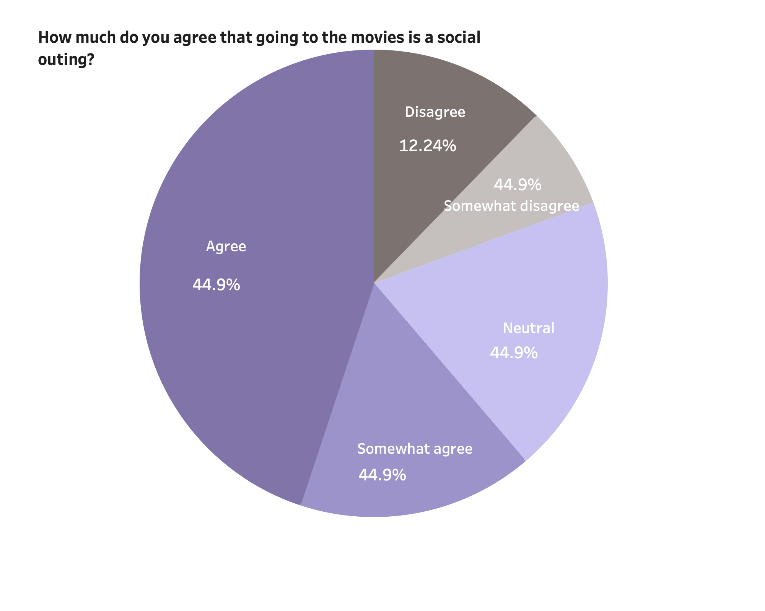
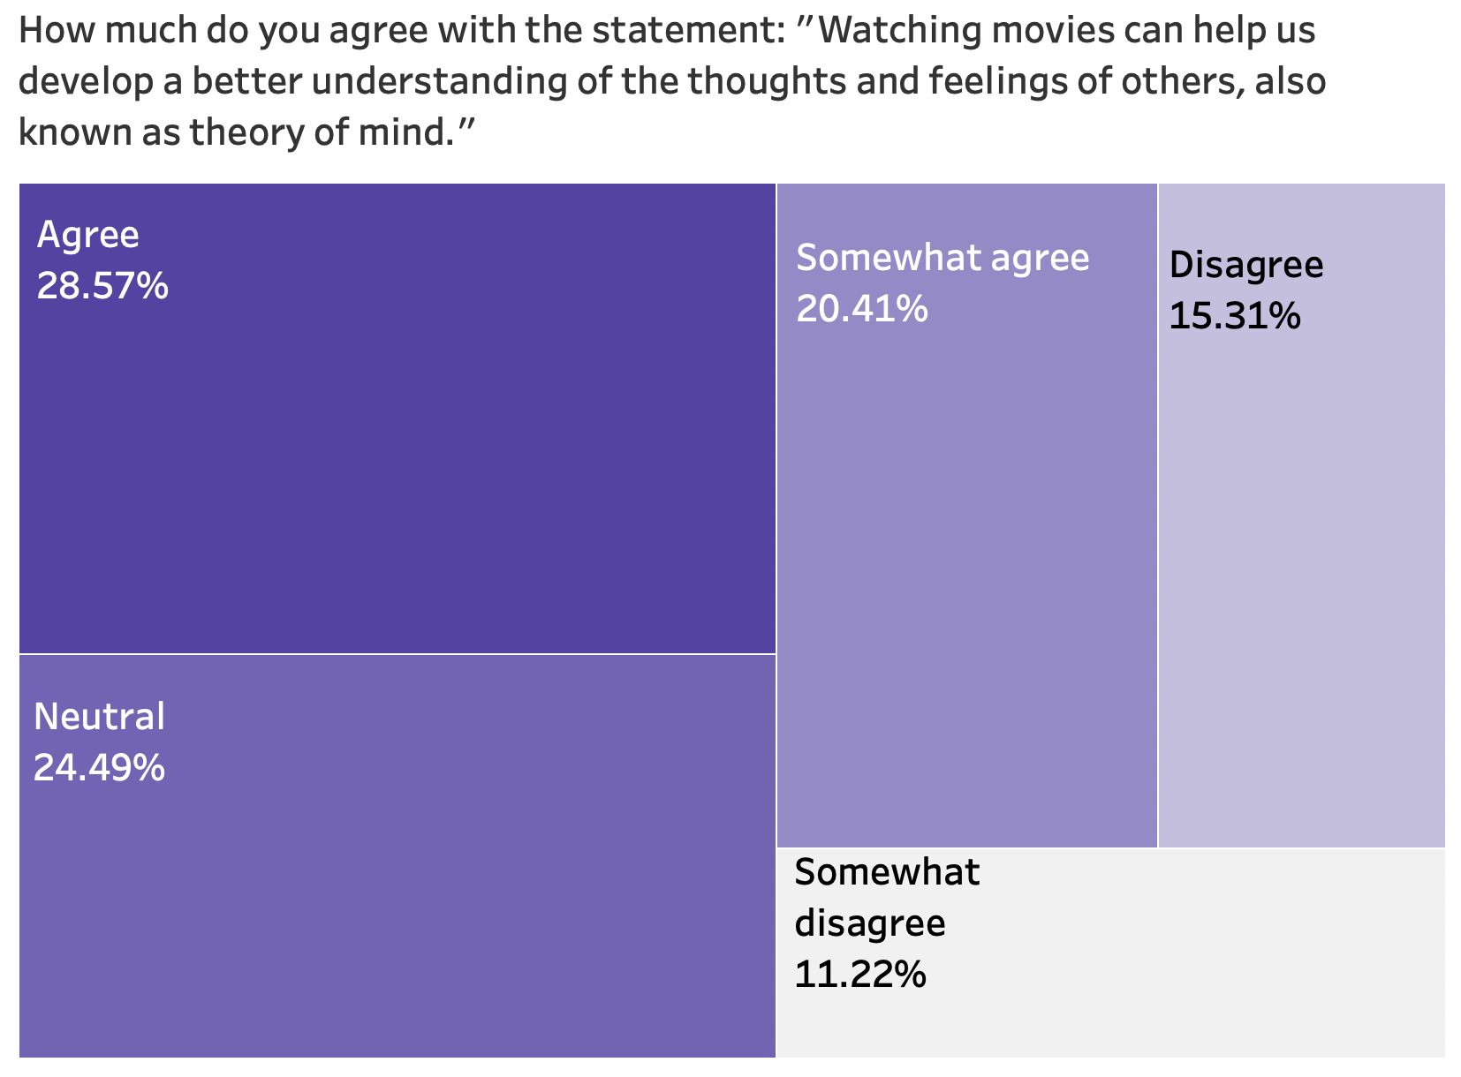

Data Analysis
Which genre do you prefer to watch in movie theater?

Slide 13
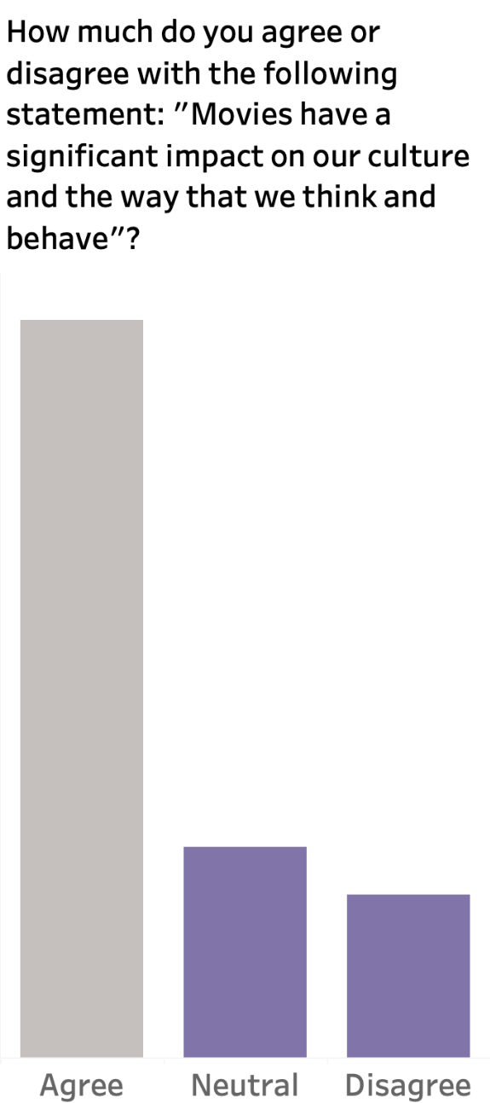
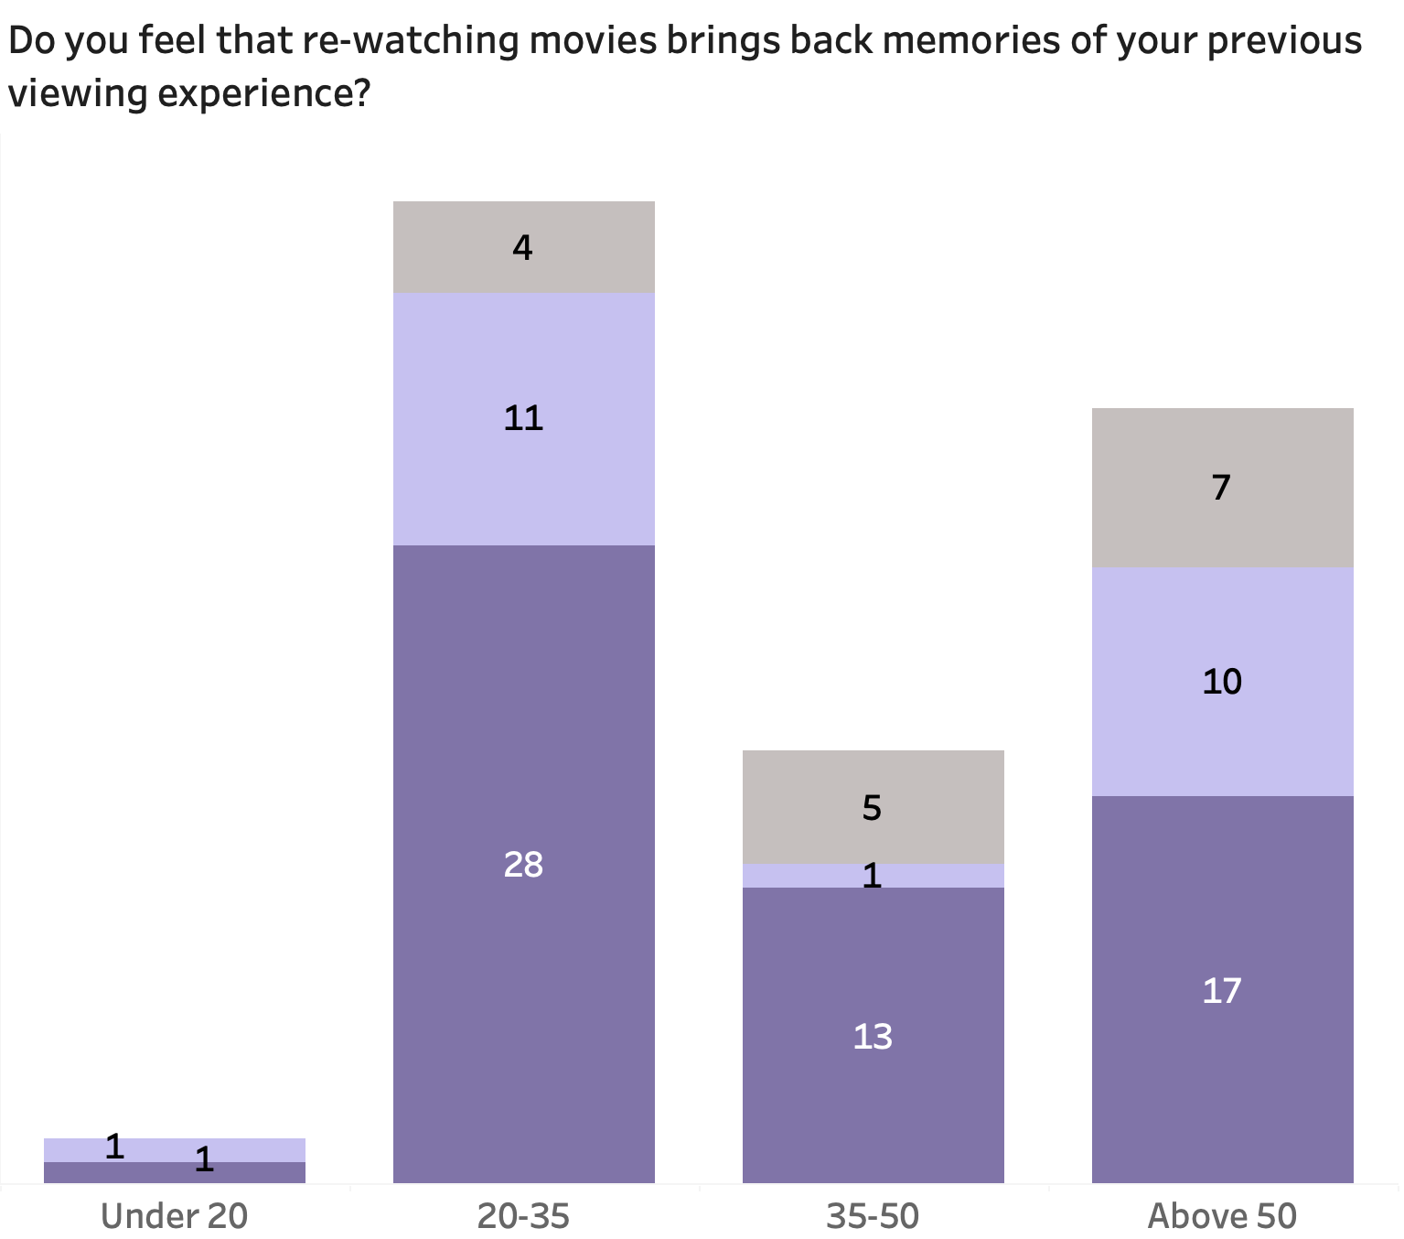
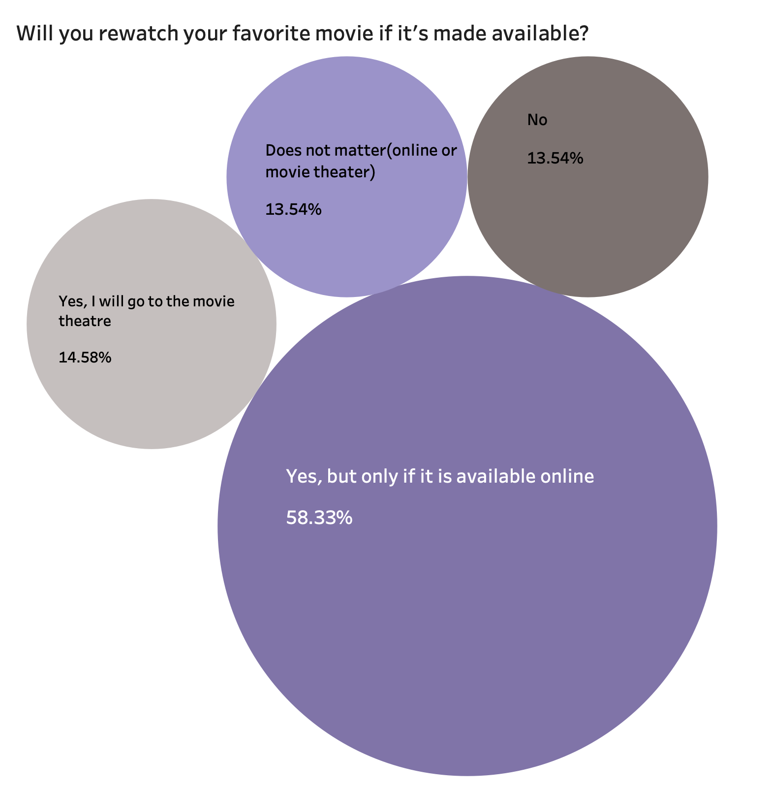
Data Analysis

Slide 14
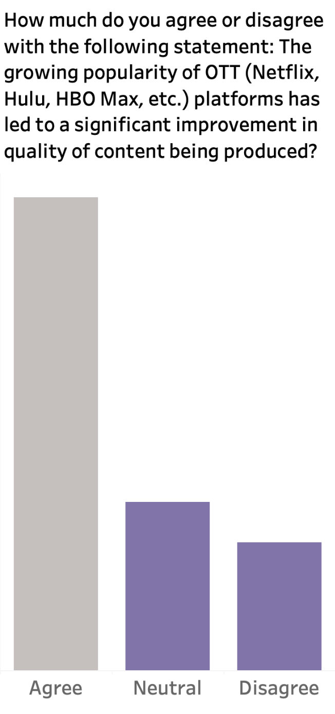
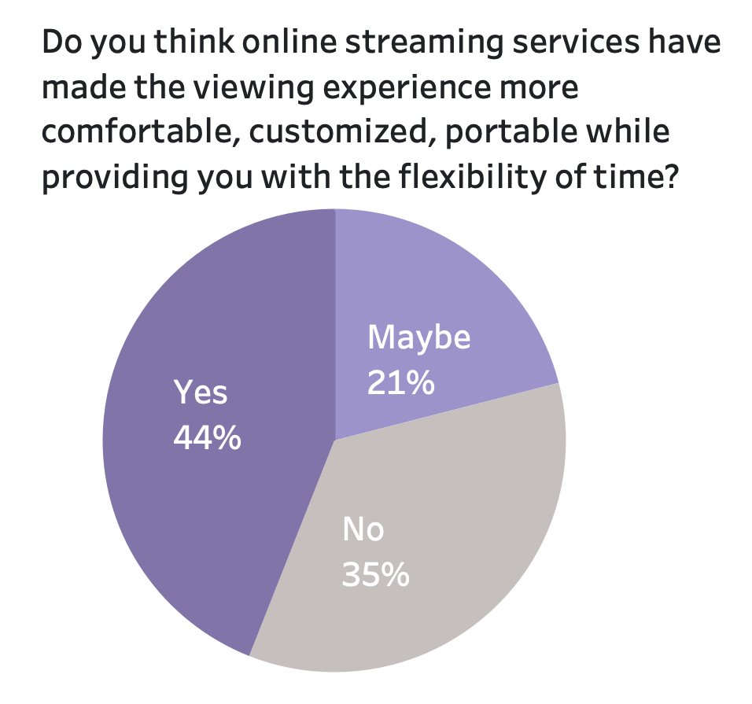
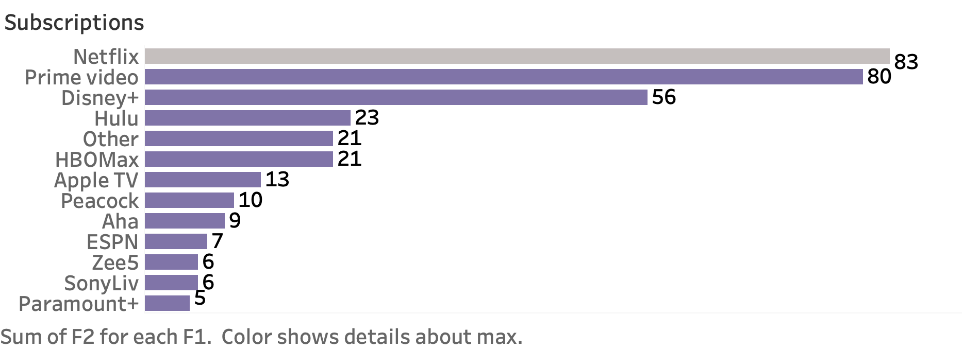
Data Analysis

Slide 15
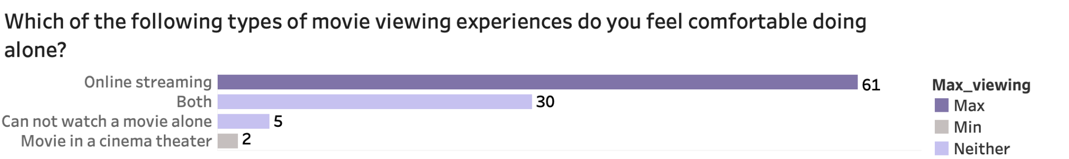
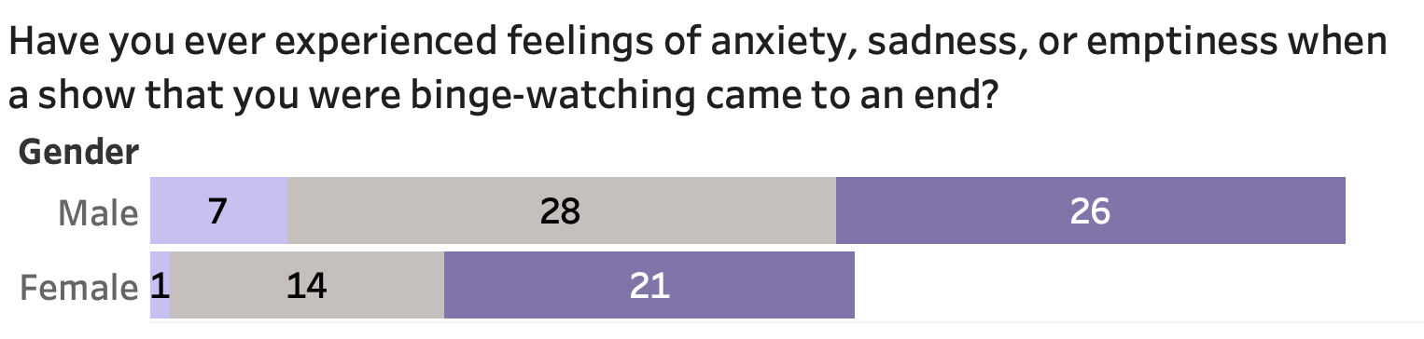
Data Analysis

Slide 16
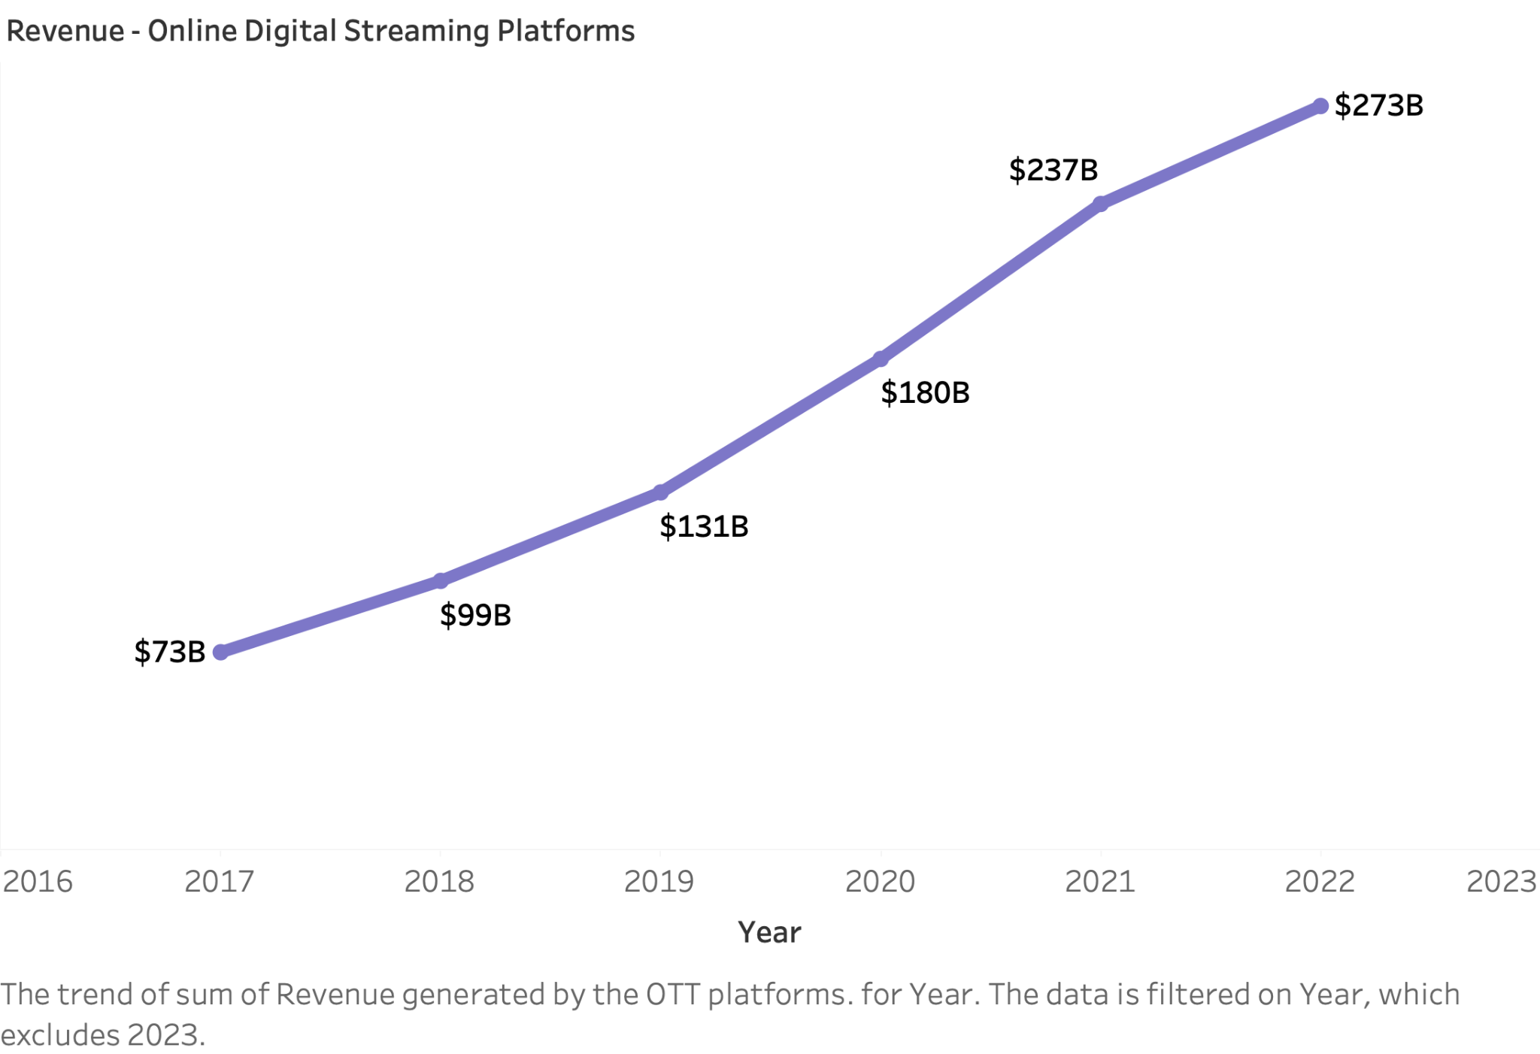
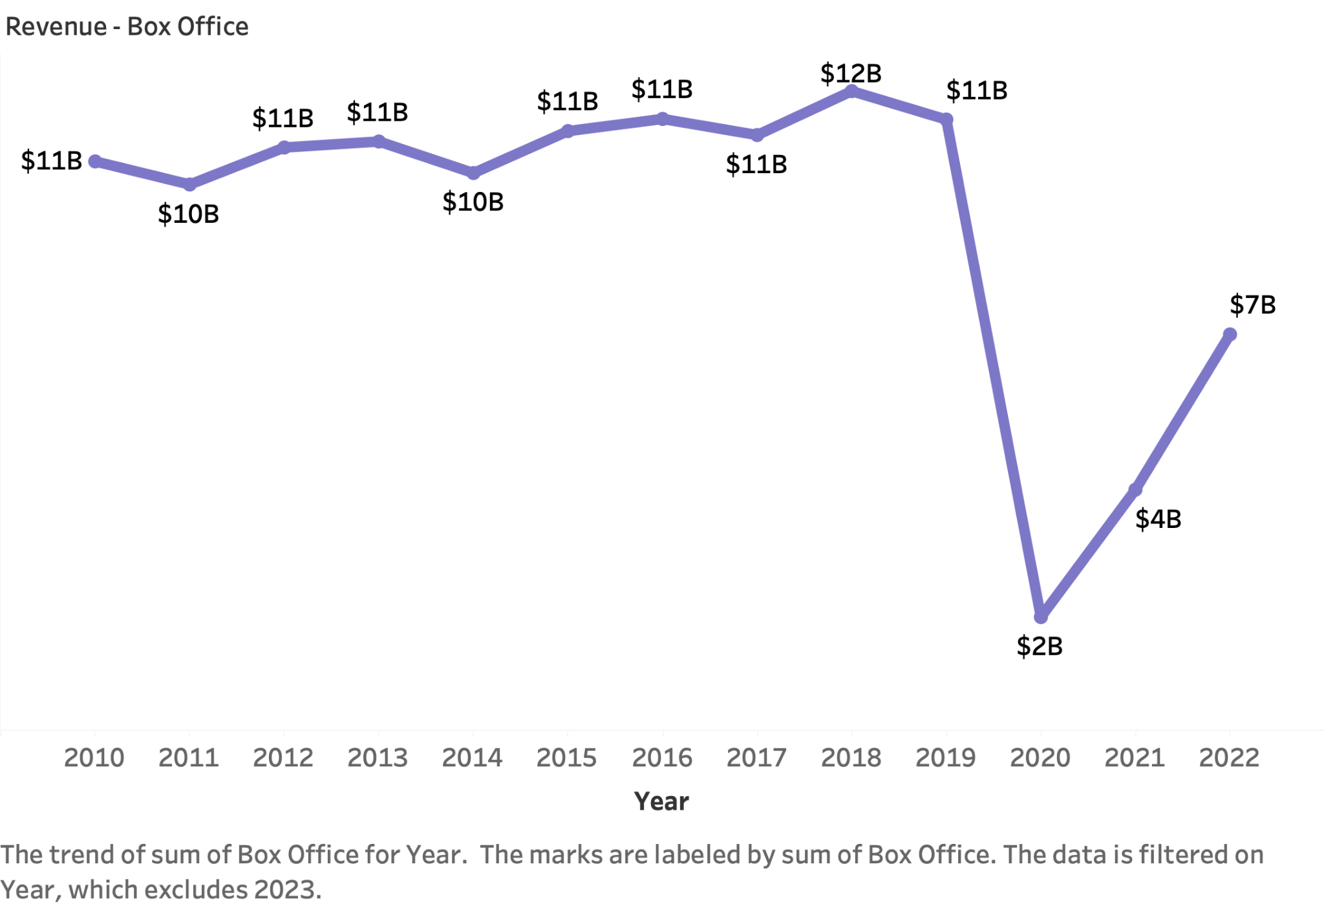
Data Analysis
Revenue stream analysis

Slide 17
Will you stop going to the movies now that online streaming platforms are available?
YES
MAYBE
NO
54.55%
27.27%
18.18%
29.41%
17.65%
52.94%
0%
50%
50%
35%
15%
50%
< 20 years
20-35 years
35-50 years
> 50 years

Slide 18
Conclusion
Online streaming platforms have become increasingly popular , providing users with enhanced viewing experiences and high-quality content. However, our quantitative study concludes that theater experience remains preferred by a significant number of individuals in all age groups and it is unlikely to be replaced by online platforms in the near future. COVID-19 lockdowns have affected box office revenues, but the situation is improving. Overall, our analysis shows that the sentiment towards the movie experience remains consistent across mediums .

Slide 19
Pivoting Strategies
Create a hybrid model by partnering with online platforms to combine digital streaming with the communal aspects of theaters, including online access to movies, events, and discussions around specific films or genres.
Hybrid Model
Utilize innovative technologies, such as virtual reality, to offer unique movie-watching experiences in online digital platforms.
Virtual Reality Integration
Expand the platform's reach by targeting new international markets as it has the advantage to connect to global audience(with help of subtitles) building bridges in various cultures by spreading awareness about the same.
Expanding Platforms’ Reach

Slide 20
References
[1]https://www.wisetour.com/why-are-movie-tickets-so-expensive.htm#:~:text=Since%20people%20are%20seeing%20fewer,prices%20of%20movie%20tickets%2C%20however.
[2]https://www.moneygeek.com/financial-planning/resources/best-streaming-services-on-a-budget/
[3]https://movieweb.com/underrated-straight-to-dvd-movies/#frozen-2010
[4]https://brandequity.economictimes.indiatimes.com/news/media/are-ott-platforms-taking-over-theatrical-experience/73887372
[5] https://guidemymba.com/blog/gd-topics/ott-vs-theatre/
[6] Is Ott Industry A Disruption To The Movie Theatre Industry? Mr. Sony Varghese, Selvin Chinnaiah, XIME, Kochi [Academy of Marketing Studies Journal , Volume 25, Issue 2, 2021
[7] Ott V Theatre: Anticipating Trends Post Pandemic , Nagendra Mani Tripathi [Palarch’s Journal Of Archaeology Of Egypt/Egyptology 17(12). ISSN 1567-214x]
[8] ​​The Future Of Movies: Will Ott Take Over Theatres , Mr. P. William Robert , Dr J JESUKULANDAI RAJ , DR. T. JOSEPH [Journal of Positive School Psychology http://journalppw.com 2022, Vol. 6, No. 3, 7614– 7620 , http://journalppw.com ]
[9] https://www.boxofficemojo.com/year/?area=US
[10]https://www.demandsage.com/ott-statistics/

